Slide 1
Collision report analysis for safer highways repository for Kentucky
2017-08-16 KYTC partnering conference
Louisville, KY

Slide 2
Access to collision data - mou
MOU between KSP and KYTC allows for
KYTC employees
KTC employees
KYTC contract / consultant employees
Other KYTC partners
Requirements for KYTC
Signed Acknowledgement for each person
Individualized justification for each person
Logging of access to information

Slide 3
Acknowledgement tracking
Inside SharePoint site – CRASH at KYTC
List of current users
Office
KYTC resources or KYOPS
Justification for access
Documents for new users
MOU
Acknowledgement

Slide 4
Using and sharing data
Everyone with access to the data – need an acknowledgement
Applies to KYTC and Consultants

Slide 5
Quick run down
Scenario
Needed Information
Where to get it

Slide 6
I have an issue
Reports of multiple collisions on KY-420 in Franklin County

Slide 7
I have a project …
Improve safety on KY-420 between mile points 1.1 and 2.2

Slide 8
I need to …
Determine what data I need

Slide 9
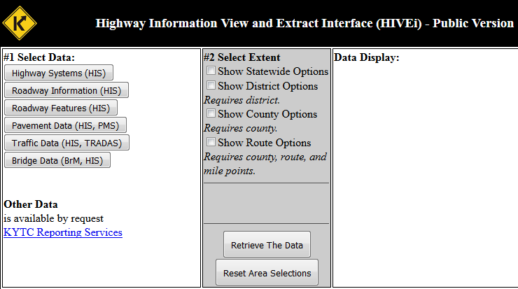
Roadway information
Use HIVEi
http://datamart.business.transportation.ky.gov/EDSB_SOLUTIONS/HISEXTRACTS/default.aspx

Slide 10
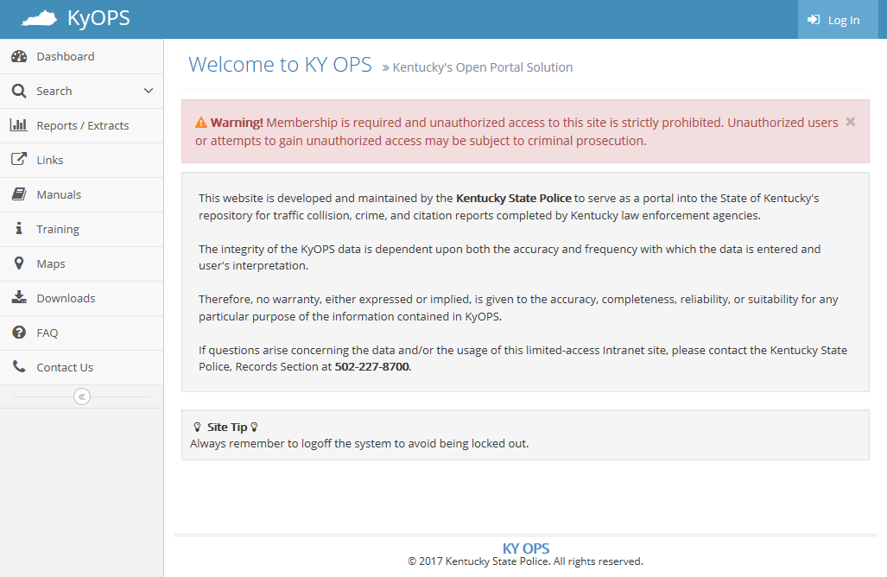
New KYOPS interface

Slide 11
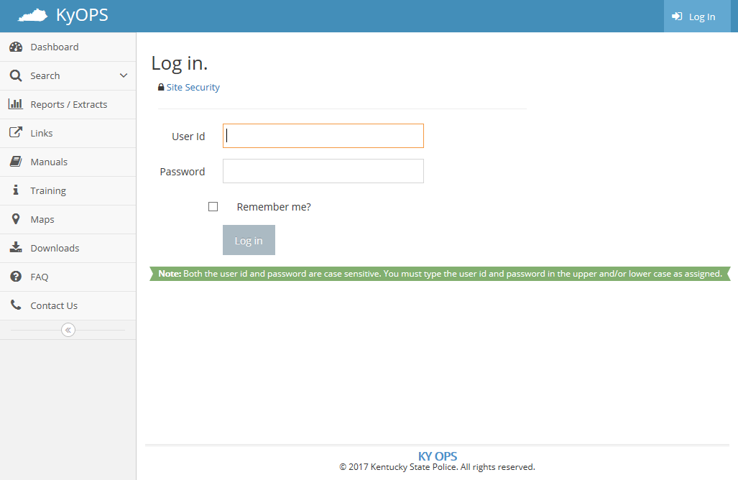
KYOPS user id - @ky.gov

Slide 12
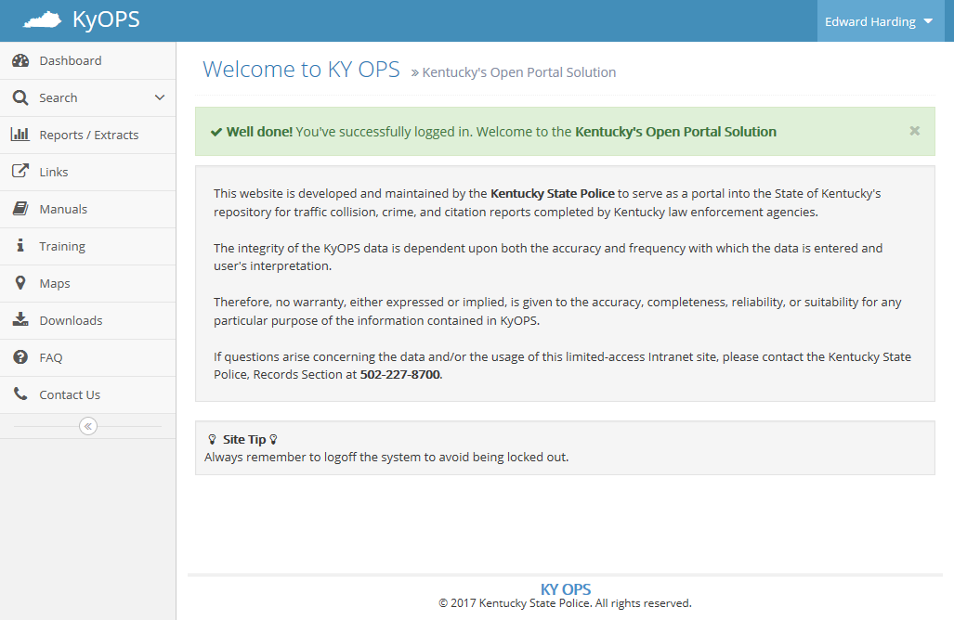
KYOPS navigation

Slide 13
KYOPS Users - personnel
KYTC personnel only
At this time
Limited users

Slide 14
KYOPS Users - training
Training required
Either attend session
Orientation with current user
Track training

Slide 15
HIS – crash asset changes
CR and CF - deprecated
CREV
Now contains new attributes

Slide 16
Bi – business intelligence
Reporting Universe
Ready/Precompiled reports
Build Your Own / Ad Hoc

Slide 17
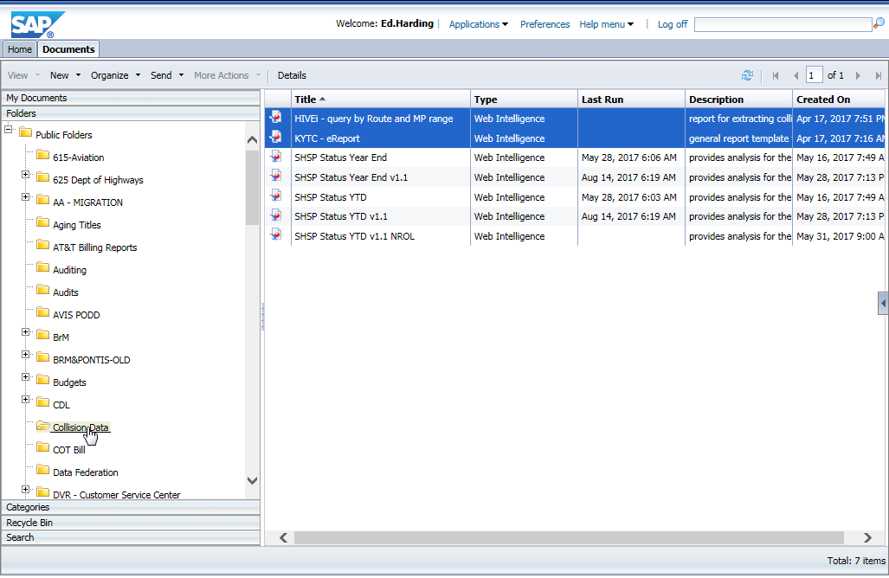
BI – ready reports

Slide 18
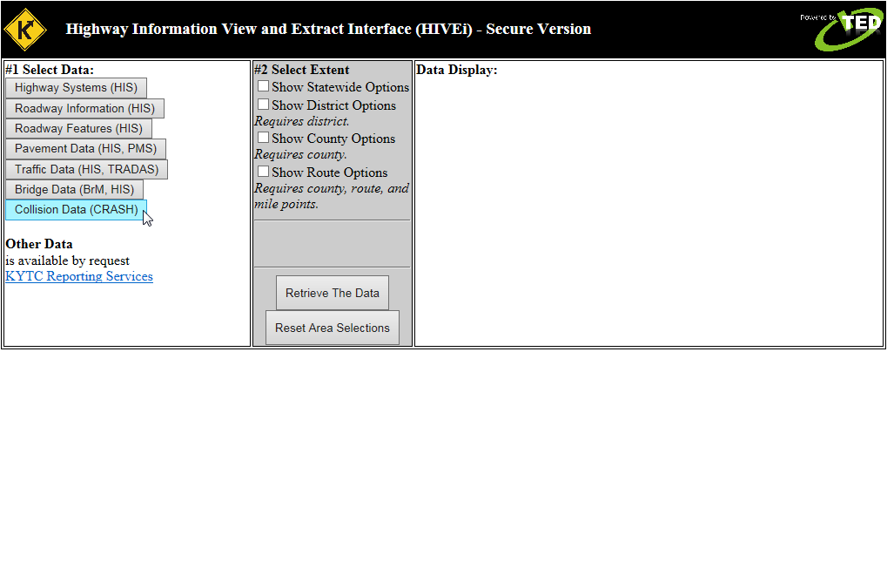
HIVEi - Secure

Slide 20
reference
CRASH at KYTC
Search on the intranet - https://intranet.kytc.ky.gov/Pages/Home.aspx
https://intranet.kytc.ky.gov/org/oit/eds/team/CRASH_KYTC/SitePages/Home.aspx
KYOPS
Old - https://kycrash.state.ky.us/KYCrash/Secure/Login.aspx
New - https://kyops.ky.gov/
Kentucky Collision Analysis for the Public
http://crashinformationky.org/KCAP/Public/Home.aspx

